Slide 1
Color and Perception
SSEP 2022 Afternoon Day 5
Dr. Ab Mosca (they/them)
Slides based on slides courtesy of Jordan Crouser: https://jcrouser.github.io/MassMutual-IntroR/, https://jcrouser.github.io/MassMutual-DataVis/, https://beanumber.github.io/sds192/

Slide 2
Perception

Slide 3
Recall
Principle 2: Effectiveness
Most effective channels should be used for most important data
Effectiveness = Based on a compilation of research, how well a channel supports:
Perceptual accuracy
Discriminability
Separability
Visual popout
Grouping

Slide 4
Recall
Principle 2: Effectiveness
Most effective channels should be used for most important data
Effectiveness = Based on a compilation of research, how well a channel supports:
Accuracy
Discriminability
Separability
Visual popout
Grouping
Perception

Slide 5
Perception
Definition: the (sometimes imperfect) process by which we detect and interpret visual signals
Understanding human perception helps us anticipate how people are likely to understand our visualizations
We can leverage perception to make better visualization tools

Slide 6
Accuracy
Definition: how close human perceptual judgement is to an objective measurement of the stimulus

Slide 7
Accuracy
Definition: how close human perceptual judgement is to an objective measurement of the stimulus
How much longer is the second bar?

Slide 8
Accuracy
Definition: how close human perceptual judgement is to an objective measurement of the stimulus
How much longer is the second bar?
2X

Slide 9
Accuracy
Definition: how close human perceptual judgement is to an objective measurement of the stimulus
How much bigger is the second square?

Slide 10
Accuracy
Definition: how close human perceptual judgement is to an objective measurement of the stimulus
How much bigger is the second square?
4X

Slide 11
Accuracy
Definition: how close human perceptual judgement is to an objective measurement of the stimulus
How much bigger is the second box?

Slide 12
Accuracy
Definition: how close human perceptual judgement is to an objective measurement of the stimulus
How much bigger is the second box?
27X

Slide 13
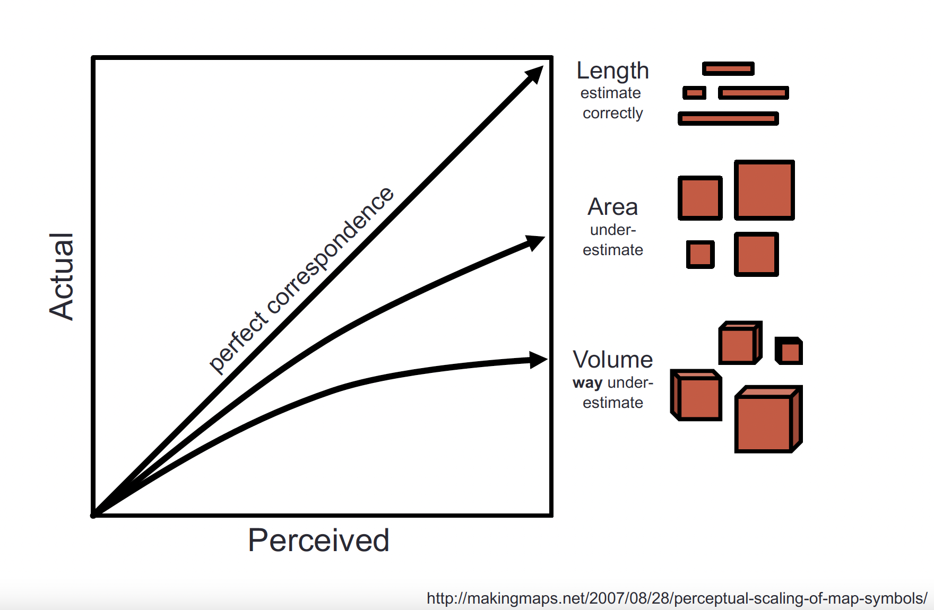
Accuracy
Definition: how close human perceptual judgement is to an objective measurement of the stimulus

Slide 14
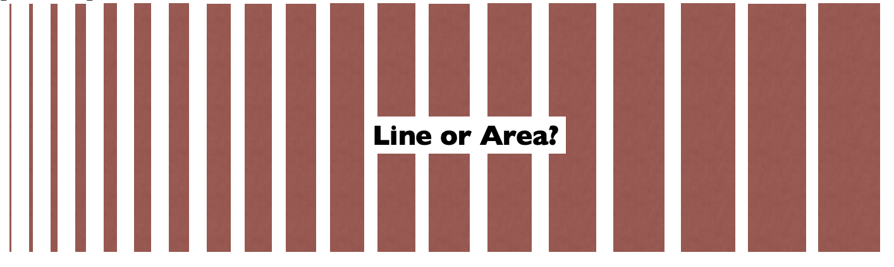
Discriminability
Definition: how differentiable different objects are

Slide 15
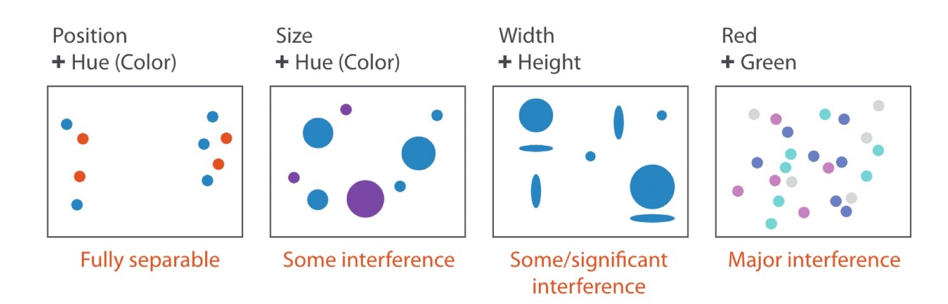
Separability
Definition: whether channels exist independently or integrally with others

Slide 16
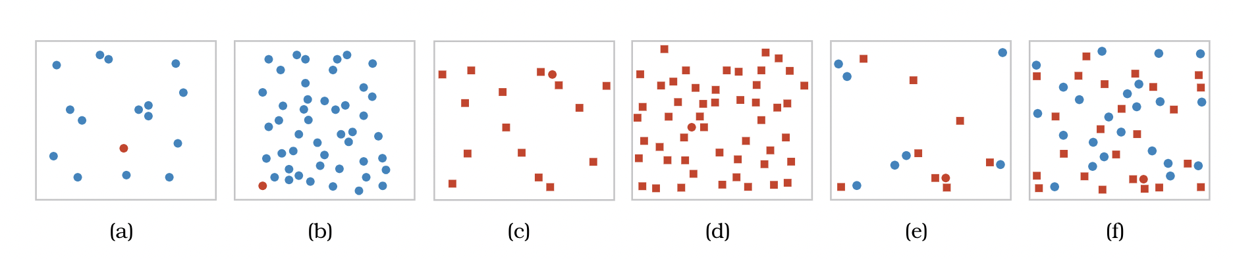
Visual Popout
Definition: how well a distinct item stands out from others

Slide 17
Visual Popout
Definition: how well a distinct item stands out from others
Color is a good channel for this

Slide 18
Visual Popout
Definition: how well a distinct item stands out from others

Slide 19
Visual Popout
Definition: how well a distinct item stands out from others
Shape is not as helpful

Slide 20
Visual Popout
Definition: how well a distinct item stands out from others

Slide 21
Visual Popout
Definition: how well a distinct item stands out from others
Combining color and shape causes “competition” – color is processed first

Slide 22
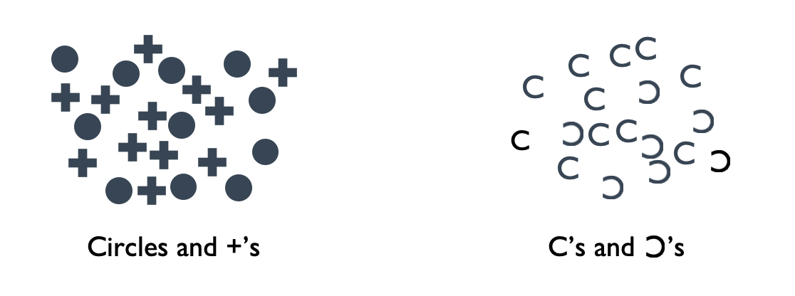
Grouping
Definition: how likely people are to infer differences as representing distinct groups

Slide 23
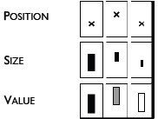
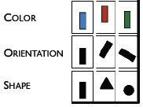
Grouping
Definition: how likely people are to infer differences as representing distinct groups
Which of these channels are best for grouping?

Slide 24
Grouping
Definition: how likely people are to infer differences as representing distinct groups
Which of these channels are best for ordering?

Slide 25
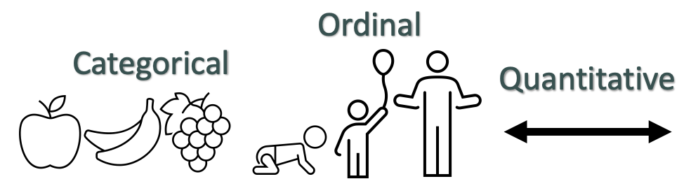

Grouping
Definition: how likely people are to infer differences as representing distinct groups
grouped | ordered
ordered
ordered
grouped
ordered
grouped

Slide 26
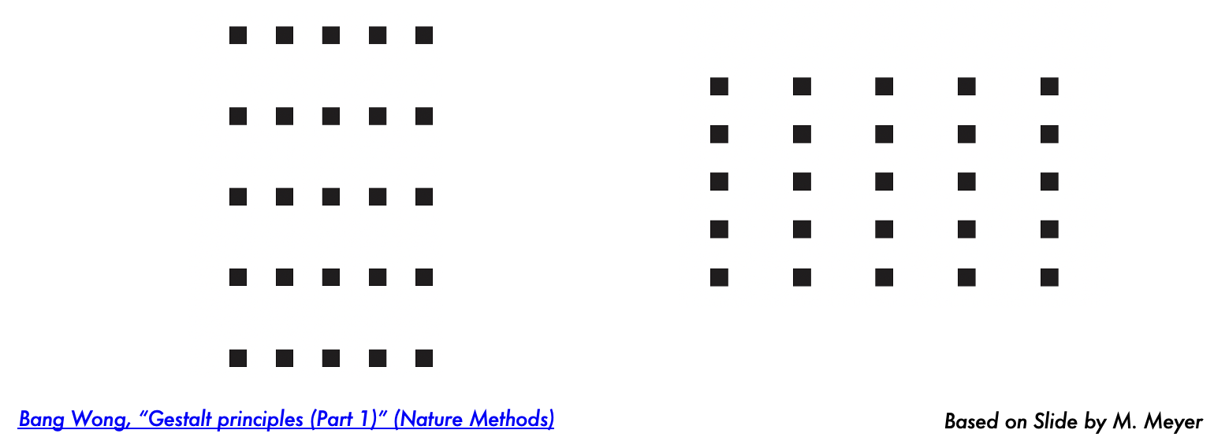

Grouping
Definition: how likely people are to infer differences as representing distinct groups

Slide 27

Grouping
Definition: how likely people are to infer differences as representing distinct groups

Slide 28
Color (and perception)

Slide 29
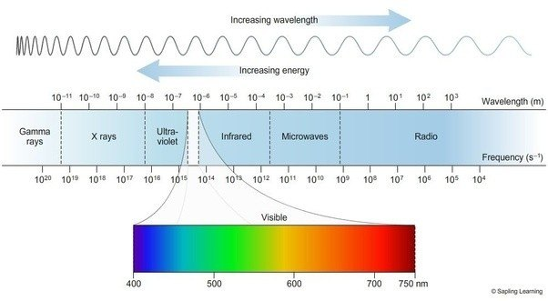
Color results from different wavelengths of light.
Color Perception
Notes:
First off, what is color?
Well, it’s how our brains process the different wavelengths of light that we’re able to see.

Slide 30
Your eye takes in light waves and translates them to lightness/darkness and color.
Color Perception
https://askabiologist.asu.edu/rods-and-cones
Notes:
On a high-level, the way that processing works is like this:
1. Light moves through the lens of the eye to the back of the eye, which is the retina. Here, there are millions of rods and cones.
2. When light hits the retina, the photons it’s made up of activate the rod and cone cells there.
3. The signal from activated rods and cones is sent along until it reaches the inner end of the rods and cones. At this point, the signal is passed to sets of neural cells. 4. Once the signal hits the neural cells, it moves through them in the optic nerve.
5. Ultimately, the optic nerve sends the signal to the brain, where it is further processed so that you see a complete image.

Slide 31

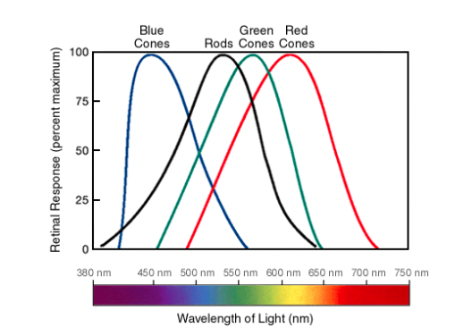
Your eye takes in light waves and translates them to lightness/darkness and color.
Color Perception
Red
Green
Blue
https://askabiologist.asu.edu/rods-and-cones
Notes:
Let’s zero in on rods and cones for a minute.
Rods can be activated in low light, while cones require much brighter light to be activated.
When rods are stimulated, we see white. Because they can be simulated by low light, that’s why we see black and white in dimly lit situations.
There are three different types of cones in our eyes. Each is most sensitive to set of light wavelengths, or color as shown by the graph on the right.
Input from all of your cones in combined to produce color.

Slide 32
Color Perception
This is why lightness/darkness is an effective encoding channel!
Rods:120 million
Cones: 5-6 million
This is why we are so sensitive to red!
Cones:
64% red-sensitive
32% green-sensitive
2% blue-sensitive.
https://askabiologist.asu.edu/rods-and-cones
Notes:
Collectively, you have about 120 million rods and 5-6 million cones in each eye.
This is why lightness/darkness is such an effective encoding channel – because we have so many rods that specialize is processing white light.
In addition to having more rods than cones, note that the distribution of the types of cones in your eyes is not even. You have far more red-sensitive cones than green or blue sensitive cones.
This uneven distribution is directly related to how sensitive our eyes are to each of these color categories.

Slide 33
Colors - Beware
For categorical attribute-color mapping, aim to maximize discriminability
vs.
Notes:
First, when working with categorical color maps you want to do your best to maximize discriminability of the colors you choose.
For example, yellow, green, and red and more discriminable than the teal, blue, and purple.

Slide 34
Colors - Beware
When possible, use semantically meaningful colors
(ex. red=hot, blue=cold)
Be aware of cultural differences
(ex. red in Chinese Culture vs Red in US culture)
Notes:
When possible, prioritize using semantically meaningful colors, and be aware of cultural differences in the perception of different colors.

Slide 35
Colors - Beware
Use colorblind safe pallets.
Notes:
Beware of whether the color maps you’re using are colorblind safe. You should always strive to be as inclusive as you can when you design your visualizations.

Slide 36
Colors - Beware
Saturation can cause illusions
High Saturation
→ Participants reported more red than green
Low Saturation
→ Participants reported equal proportions (which is correct)
Cleveland & McGill, “A Color-Caused Optical Illusion on a Statistical Graph”, 1983
Notes:
Be aware that there’s an interference between saturation and perception of area for some colors.

Slide 37
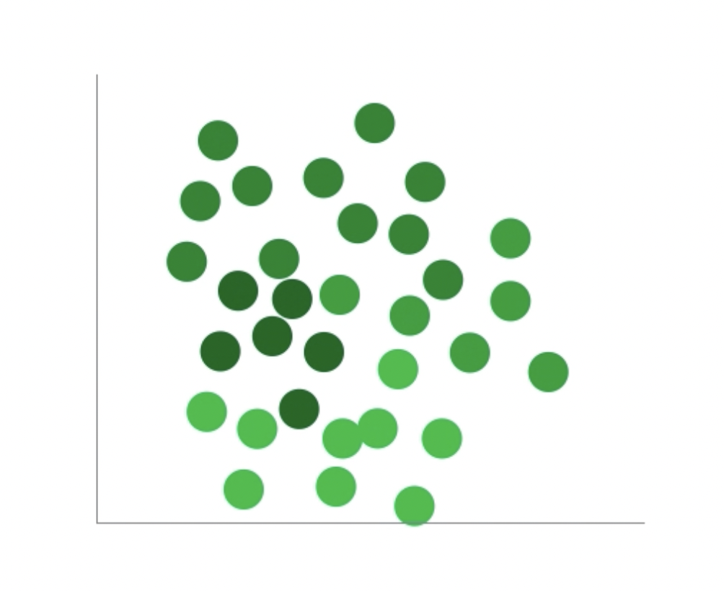
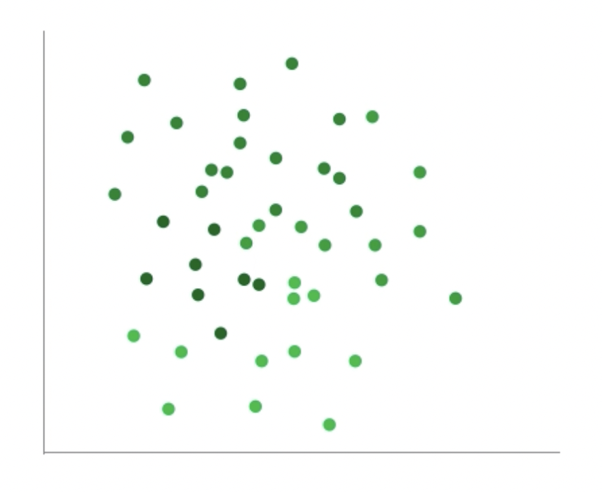
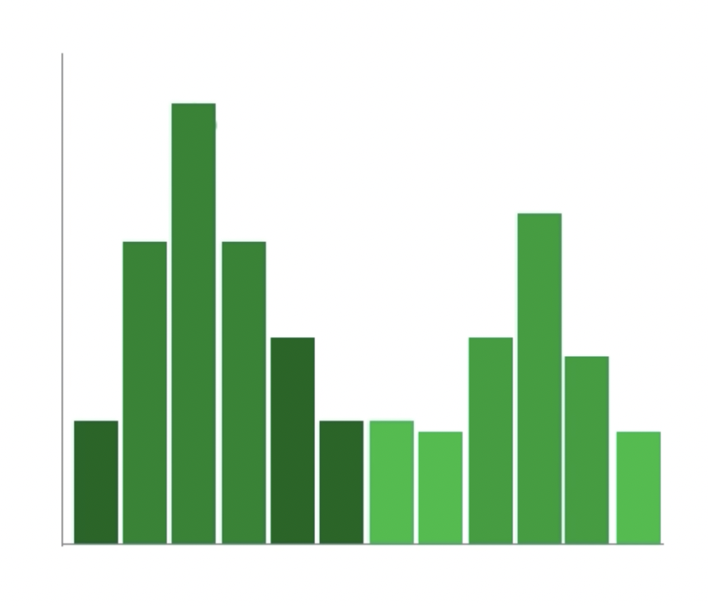
Colors - Beware
Mark type and size effects how we perceive color
How many categories?
Szafir. Modeling Color Differences for Visualization Design
Notes:
Similarly, be aware that there is an interference between size and types of marks you use and how color is perceived.

Slide 38
Colors - Beware
Is the smaller rectangle a solid color or gradient?
Notes:
Beware of simultaneous contrast. For example, who thinks the rectangle on the foreground is a solid color and who thinks is it colored with a gradient?

Slide 39
Colors - Beware
Simultaneous contrast – using a gradient as a background can distort how we see the foreground
→ Avoid using gradients as backgrounds
Notes:
Beware of whether the color maps you’re using are colorblind safe. You should always strive to be as inclusive as you can when you design your visualizations.

Slide 40
Colors - Beware
Are the smaller rectangles the same color or different colors?
Notes:
How about here, are the two rectangles in the foreground the same color or different?

Slide 41
Colors - Beware
Simultaneous contrast – solid backgrounds can distort how we see foreground shapes
Notes:
Beware of whether the color maps you’re using are colorblind safe. You should always strive to be as inclusive as you can when you design your visualizations.

Slide 42
Colors - Beware
Simultaneous contrast – solid backgrounds can distort how we see foreground shapes
Notes:
Beware of whether the color maps you’re using are colorblind safe. You should always strive to be as inclusive as you can when you design your visualizations.

Slide 43
Colors - Beware
Are the smaller rectangles the same color or different colors?
Notes:
Is this also true with colors? Are these greens the same or different?

Slide 44
Colors - Beware
#009C59
#009051
Different!
Notes:
Is this also true with colors? Are these greens the same or different?

Slide 45
Colors - Beware
Are the smaller rectangles the same color or different colors?
Notes:
Is this also true with colors? Are these greens the same or different?

Slide 46
Colors - Beware
Simultaneous contrast – solid backgrounds can distort how we see foreground shapes

Slide 47
Colors - Beware
Simultaneous contrast – solid backgrounds can distort how we see foreground shapes

Slide 48
Colors - Beware
Von Bezold Spreading Effect – borders can change the appearance of shape’s colors
Notes:
Last but not least, beware of the von bezold spreading effect, which means borders can change the appearance of shapes colors. For example here who would say the shapes on the right are darker than those on the left?
This is something to be especially aware of when you’re formatting your legends for charts. If you use a border there but not on your chart people might not think they are looking at the same color.

Slide 49
Colormaps
Help us choose the correct colors to represent different data types
Categorical
Sequential
Divergent

Slide 50
Categorical
Different color = different category
Protip #1: choose colors that are perceptually distant
Protip #2: choose colors that are roughly the same saturation and value
Work with the person next to you to find an example of a visualization with a categorical color scheme
You can look anywhere you want, but here are some potential sources: FiveThirtyEight, New York Times, Wall Street Journal, Tableau Viz of the Day
Add your example to the appropriate page of the Jamboard here: Colormap Examples

Slide 51
Sequential
Saturation indicates difference in the amount of the phenomenon
Protip #1: no more than 5-6 levels
Protip #2: people interpret darker as meaning more
Work with the person next to you to find an example of a visualization with a sequential color scheme
You can look anywhere you want, but here are some potential sources: FiveThirtyEight, New York Times, Wall Street Journal, Tableau Viz of the Day
Add your example to the appropriate page of the Jamboard here: Colormap Examples

Slide 52
Divergent
Two colors used to indicate extremes of a range
Protip #1: neutral color in the middle
Protip #2: differentiate between “average” or midpoint and “no data”
Work with the person next to you to find an example of a visualization with a divergent color scheme
You can look anywhere you want, but here are some potential sources: FiveThirtyEight, New York Times, Wall Street Journal, Tableau Viz of the Day
Add your example to the appropriate page of the Jamboard here: Colormap Examples

